Slide 1
London Boroughs historical House Price study
Manuel Gomez

Slide 2
London Boroughs historical House Price study
Objective
Determine which boroughs in London experienced the greatest increase in average housing prices from 1998-2018
Data
UK house price index
Data.London.gov.uk
Monthly average house price from 1995 – 2020
48 boroughs

Slide 3
Results
 | London Borough | 1998 Avg Price | 2018 Avg Price | Ratio | Increase Factor |  | London Borough | 1998 Avg Price | 2018 Avg Price | Ratio | Increase Factor
1 | Hackney | 87,869.54 | 544,640.48 | 0.1613 | 6.20 | 17 | Tower Hamlets | 96,505.17 | 446,500.55 | 0.2161 | 4.63
2 | Waltham Forest | 75,557.47 | 440,859.41 | 0.1714 | 5.83 | 18 | Redbridge | 94,514.4 | 422,591.07 | 0.2237 | 4.47
3 | Southwark | 91,405.19 | 504,235.37 | 0.1813 | 5.52 | 19 | Barnet | 122,359.47 | 533,266.53 | 0.2295 | 4.36
4 | Lewisham | 75,539.05 | 411,628.99 | 0.1835 | 5.45 | 20 | Havering | 85,602.09 | 370,248.75 | 0.2312 | 4.33
5 | Westminster | 190,531.95 | 1,020,025.25 | 0.1868 | 5.35 | 21 | Ealing | 111,343.15 | 480,050.54 | 0.2319 | 4.31
6 | Newham | 67,671.27 | 359,022.51 | 0.1885 | 5.31 | 22 | Kingston upon Thames | 116,399.77 | 497,090.98 | 0.2342 | 4.27
7 | Haringey | 107,419.85 | 551,560.64 | 0.1948 | 5.13 | 23 | Enfield | 93,030.22 | 396,631.72 | 0.2346 | 4.26
8 | Kensington & Chelsea | 268,350.12 | 1,363,880.12 | 0.1968 | 5.08 | 24 | Bexley | 80,632.02 | 342,603.61 | 0.2354 | 4.25
9 | Lambeth | 103,179.12 | 511,536.4 | 0.2017 | 4.96 | 25 | Croydon | 88,143.23 | 370,298.54 | 0.2380 | 4.20
10 | Camden | 170,688.97 | 842,410.41 | 0.2026 | 4.94 | 26 | Hillingdon | 97,676.05 | 410,266.08 | 0.2381 | 4.20
11 | Barking & Dagenham | 60,285.82 | 295,196.67 | 0.2042 | 4.90 | 27 | Hammersmith & Fulham | 175,340.92 | 725,525.33 | 0.2417 | 4.14
12 | Brent | 100,692.59 | 492,845.37 | 0.2043 | 4.89 | 28 | Sutton | 92,087.05 | 379,262.58 | 0.2428 | 4.12
13 | Islington | 134,148.97 | 649,824.07 | 0.2064 | 4.84 | 29 | Bromley | 108,286.52 | 443,409.99 | 0.2442 | 4.09
14 | Wandsworth | 125,406.81 | 596,649.14 | 0.2102 | 4.76 | 30 | Harrow | 114,778.25 | 465,907.46 | 0.2464 | 4.06
15 | Greenwich | 81,532.93 | 388,344.33 | 0.2100 | 4.76 | 31 | Richmond upon Thames | 162,956.07 | 652,665.43 | 0.2497 | 4.01
16 | Merton | 108,049.86 | 512,293.89 | 0.2109 | 4.74 | 32 | Hounslow | 99,746.07 | 396,631.18 | 0.2515 | 3.98

Slide 4
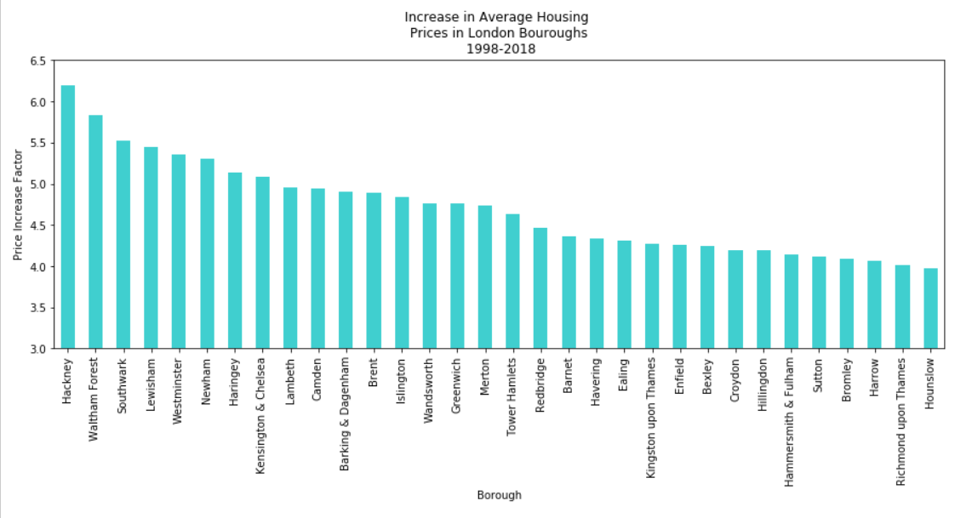
Conclusions

Slide 5
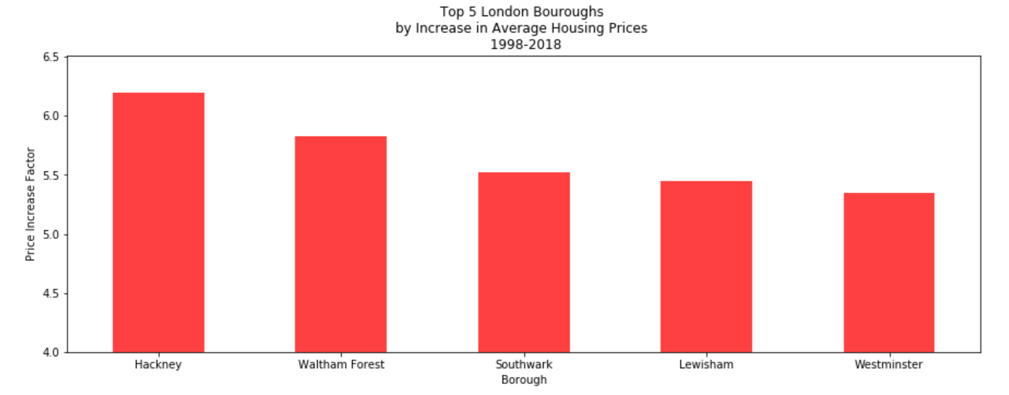

Slide 6
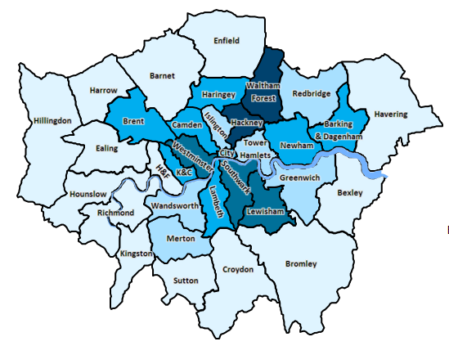
Geographical Distribution
Legend
 | Increase Factor
Levels | Low (>=) | (<) High | Occurrences
1 | 4.0 | 4.4 | (14)
2 | 4.4 | 4.9 | (6)
3 | 4.9 | 5.3 | (7)
4 | 5.3 | 5.8 | (3)
5 | 5.8 | 6.2 | (2)
https://data.london.gov.uk/dataset/excel-mapping-template-for-london-boroughs-and-wards

Slide 7
Assignment Challenges
Technical
Issue recognizing NaT as column header – used .iloc workaround
Delay in chart generation resulted in new prompt to be displayed on top (before) of generated chart
Fixed with time.sleep(1)
Conceptual
Melt
Initially unsure about the reason for this
Referred to tier 2 notebook for clarification
Modeling
Calculated price ratio as recommended by notebook
Found metric confusing as lower number indicates a higher increase in price
Added calculation of Price Increase Factor ( 2018 Price / 1998 Price)
Indicates the magnitude of the price increase
Higher number = higher increase

Slide 8
Next Questions
Conduct similar analysis on average salary of population by borough
Where does the correlation match?
Where is it different?
Conduct gentrification analysis on top 5 boroughs
With the sharp increase in housing price on these boroughs, identify income demographics forced to move to another sector

